Slide 1

Deanery Meeting Pre Reading
11th November 2025

Slide 2
Context - where we are today

Slide 3
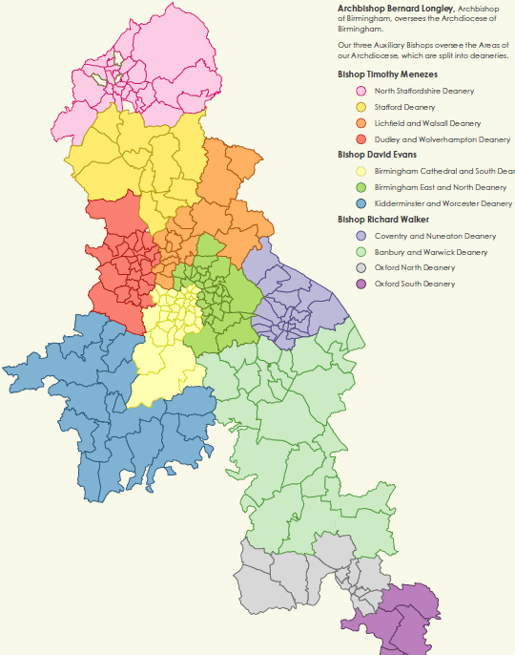
The Archdiocese in Numbers
The Archdiocese of Birmingham serves the Catholic population through a network of 217 parishes and some 239 maintained schools in addition to several chaplaincies in hospitals, prisons, universities and other chaplaincies catering for specific communities and groups.
Geographically, it is the largest Archdiocese in England and Wales, covering seven cities within five counties, from Staffordshire in the north, to Oxfordshire in the south.

Slide 4
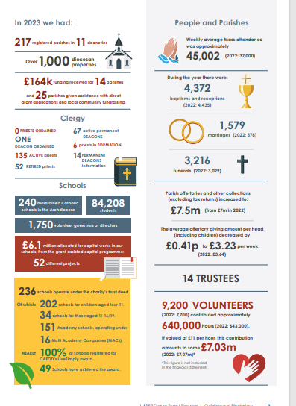

In 2023 we had:

Slide 5
Trends 2013 – 2023

Slide 6
Mass Attendance and Voluntary Giving
Mass attendance by year
Voluntary giving vs inflation (RPI)

Slide 7
Operating Position
Parish
Other Activities – Care of Clergy, Curia, Shared Costs
 | 2020 | 2021 | 2022 | 2023 | 2024
Income | 14,870 | 15,852 | 17,279 | 18,989 | 21,105
Expenditure | 14,165 | 13,615 | 14,513 | 17,194 | 18,518
Operating surplus/(loss) | 705 | 2,237 | 2,766 | 1,795 | 2,587
Investment gain/(loss) | 2,089 | 5,872 | -1,231 | 1,206 | 5,093
Total surplus/(loss) | 2,794 | 8,109 | 1,535 | 3,001 | 7,680
 | 2020 | 2021 | 2022 | 2023 | 2024
Income | 4,626 | 2,443 | 2,856 | 4,720 | 3,077
Expenditure | 9,688 | 9,252 | 7,635 | 7,857 | 7,353
Operating surplus/(loss) | -5,062 | -6,809 | -4,779 | -3,137 | -4,276
Investment gain/(loss) | 457 | 1,562 | -2,900 | 841 | 1,039
Total surplus/(loss) | -4,605 | -5, 247 | -6,679 | -2,296 | -3,237
Archdiocese (total charity)
50% of parishes
had an operating
deficit in 2023 and 24
 | 2020 | 2021 | 2022 | 2023 | 2024
Income | 19,496 | 18,295 | 20,135 | 23,709 | 24,182
Expenditure | 23,853 | 22,867 | 2,148 | 25,051 | 25,871
Operating surplus/(loss) | -4,357 | -4,572 | -2,013 | -1,342 | -1,689
Investment gain/(loss) | 2,546 | 7,434 | -3,131 | 2,047 | 6,132
Total surplus/(loss) | -1,811 | 2,862 | -5,144 | 705 | 4,443
Other activities
have a cumulative
Operating loss of circa £24m
since 2020
*Investment gains are notional/paper gains and as in 2022 can go down as well as up, and do not deliver
CASH for day to day expenses. The operating position provides a more accurate picture of our finances

Slide 8
Asset split between Parish and non parish
Assets Totals
 | ALL FUNDS * |  | UNRESTRICTED FUNDS ** |  | No of years reserves available***
 | £’000 | % | £’000 | %
Parish | 108,749 | 1 | 101,896 | 1 | 19.51
Curia | 14,047 | 0 | 10,305 | 0 | 5.09
Other Diocesan | 1,965 | 0 | -3,333 | -0
Total | 125,121 | 1 | 108,868 | 1
*(excluding debtors/creditors & internal debtors/creditors)
**(incl internal and external debtors/creditors
***(Using operating deficits)
Distribution of Assets by Parishes (£)
(excl functional property)
 | Cash | Listed Investments | Investment property
20% of parishes with highest asst value | 7,985,804 | 18,795,096 | 21,118,110
60% of parishes with average asset value | 9,457,010 | 8,712,775 | 12,256,000
20% of parishes with lowest asset value | -8,968,300 | 249,167 | 523,000
Totals | 8,424,514 | 27,757,038 | 33,897,110

Slide 9
Non parish Income and Expenditure
 | 2024 |  | 2023
Income | £’000 | % of income | £’000 | % of income
Income from parish levy | 3,040 | 65.9% | 2,535 | 62.5%
Other income | 385 | 8.4% | 712 | 17.5%
Income and gains from investments | 1,185 | 25.7% | 811 | 20%
Total | 4,610 | 100% | 4,058 | 100%
 | 2024 | 2023
Total income | 4,610 | 4,058
Total expenditure | 5,451 | 5,872
Total loss | -841 | -1,814
Shortfall covered by sale of assets | 0 | 2,088
(Loss)/Surplus | -841 | 274
Due to difficult market conditions, no property was sold in 2024
 | 2024 |  | 2023
Expenditure | £’000 | % of expenditure | £’000 | % of expenditure
Clergy and clerical costs | 1,083 | 20% | 1,614 | 29.6%
Curia staffing, welfare and training costs | 1,510 | 28% | 1,728 | 31.7%
Internal and external grants | 1,066 | 20% | 1,115 | 20.5%
Other essential costs | 1,404 | 26% | 986 | 18.1%
Property and buildings costs | 387 | 7% | 429 | 7.9%
Total | 5,450 | 100% | 5,872 | 108%

Slide 10
Curial Office Income and Expenditure 2024 (£’000)
Expenditure | 2024 |  | 2023
 | £'000 | % of expenditure | £'000 | % of expenditure
Clergy & Clerical Costs | 1,083 | 20% | 1,169 | 20%
Active clergy (incl senior clergy) | 461 | 8% | 397 | 7%
Retired clergy | 374 | 7% | 352 | 6%
Other clergy costs | 48 | 1% | 137 | 2%
Clergy Training Fund | 200 | 4% | 283 | 5%
Curia staffing, welfare and training costs | 1,510 | 28% | 1,452 | 25%
Safeguarding | 263 | 5% | 211 | 4%
Property and grant applications | 356 | 7% | 353 | 6%
Finance and IT | 227 | 4% | 226 | 4%
Planning and communications | 141 | 3% | 144 | 2%
Marriage tribunal | 98 | 2% | 97 | 2%
Ongoing formation and evangelisation | 90 | 2% | 87 | 1%
General admin, legal and compliance | 335 | 6% | 334 | 6%
Internal and external grants | 1,066 | 20% | 1,115 | 19%
Catholic education (DES/Maryvale) | 620 | 11% | 595 | 10%
All other internal grants incl chaplaincies | 204 | 4% | 174 | 3%
Kenelm Youth Trust | 200 | 4% | 304 | 5%
Other grants to external charities | 42 | 1% | 42 | 1%
Essential/statutory costs | 1,404 | 26% | 1,707 | 29%
IT, equipment, maintenance, software licenses | 208 | 4% | 274 | 5%
Professional fees (HR, audit. safeguarding, property etc) | 301 | 6% | 145 | 2%
Office and administration, printing, publications | 85 | 2% | 49 | 1%
DBS checks | 15 | 0% | 12 | 0%
Interest | 30 | 1% | 47 | 1%
Other costs* | 21 | 0% | 459 | 8%
Other centrally funded service costs | 278 | 5% | 276 | 5%
Other liturgical and pastoral costs | 258 | 5% | 241 | 4%
National Diocesan Levies | 208 | 4% | 204 | 3%
Property and buildings costs | 387 | 7% | 429 | 7%
Functional property costs (incl depreciation) | 338 | 6% | 408 | 7%
Investment property costs | 49 | 1% | 21 | 0%
Total | 5,450 | 100% | 5,872 | 100%

Slide 11
2013 – 2024 Employee Costs
 | 2013 | 2019 | 2023 | 2024 | % Change
Parish | 1,112 | 1,753 | 1,831 | 1,993 | 79%
Non Parish | 2,039 | 3,269 | 3,226 | 3,162 | 55%
Total | 3,151 | 5,022 | 5,057 | 5,156 | 64%
Almost £2m being spent in the parishes on staff

Slide 12
Total Asset Value (by deanery)
Deanery | Parishes | Asset Value | Average Asset Value
BANBURY & WARWICK | 22 | £10,938,906 | £497,223
BIRMINGHAM CATHEDRAL & SOUTH | 29 | £6,704,420 | £231,187
COVENTRY & NUNEATON | 21 | £6,389,120 | £304,244
DUDLEY & WOLVERHAMPTON | 26 | £7,995,888 | £307,534
KIDDERMINSTER & WORCESTER | 13 | £4,201,221 | £323,171
LICHFIELD & WALSALL | 16 | £7,634,194 | £477,137
BIRMINGHAM EAST AND NORTH | 31 | £9,405,327 | £303,398
NORTH STAFFORDSHIRE | 27 | £7,119,992 | £263,703
OXFORD NORTH | 11 | £2,307,001 | £209,727
OXFORD SOUTH | 7 | £1,739,727 | £248,533
STAFFORD | 12 | £5,578,006 | £464,834
Total Asset Value | 215 | £70,013,803
Average Deanery Asset Value |  |  | £313,347

Slide 13
Top 20% Parishes by Asset Value (Deanery View)
Deanery | How Many Parishes | Asset Value
BANBURY & WARWICK | 7 | £7,601,362
BIRMINGHAM CATHEDRAL AND SOUTH | 6 | £6,035,273
LICHFIELD & WALSALL | 5 | £6,010,153
DUDLEY & WOLVERHAMPTON | 4 | £5,371,819
STAFFORD | 5 | £5,155,068
BIRMINGHAM EAST AND NORTH | 4 | £4,895,306
COVENTRY & NUNEATON | 5 | £4,454,039
NORTH STAFFORDSHIRE | 3 | £2,999,323
KIDDERMINSTER & WORCESTER | 2 | £1,740,692
OXFORD NORTH | 1 | £1,529,935
OXFORD SOUTH | 1 | £1,387,339
Top 20 % | 43 | £47,180,307

Slide 14
Bottom 20% Parishes by Asset Value (Deanery View)
Deanery | How Many Parishes | Asset Value
LICHFIELD & WALSALL | 3 | -£62,395
KIDDERMINSTER & WORCESTER | 2 | -£76,826
NORTH STAFFORDSHIRE | 6 | -£167,382
DUDLEY & WOLVERHAMPTON | 7 | -£176,367
STAFFORD | 2 | -£209,455
OXFORD SOUTH | 2 | -£246,281
COVENTRY & NUNEATON | 4 | -£603,627
BIRMINGHAM EAST AND NORTH | 7 | -£763,336
BANBURY & WARWICK | 2 | -£881,396
OXFORD NORTH | 3 | -£1,062,338
BIRMINGHAM CATHEDRAL AND SOUTH | 5 | -£3,935,072
Bottom 20 % | 43 | -£8,184,475

Slide 15
Breakdown of Top 20% (by parish)

Slide 16
Breakdown of Bottom 20% (by parish)

Slide 17
2030 - if we continue as we are
20+ fewer active priests and 10+ fewer deacons.
Parish Priests at risk of physical and mental burnout due to falling numbers and trying to run multiple parishes
Increased reliance on overseas priests
20% of parishes will fail financially and another 20% of parishes will be heading for financial ‘closure’.
10 -20 properties at immediate risk and 50+ at risk of closure due to lack of investment and H&S concerns with many others requiring significant investment.
Declining attendance due to aging demographic and lack of young families.

