Slide 1
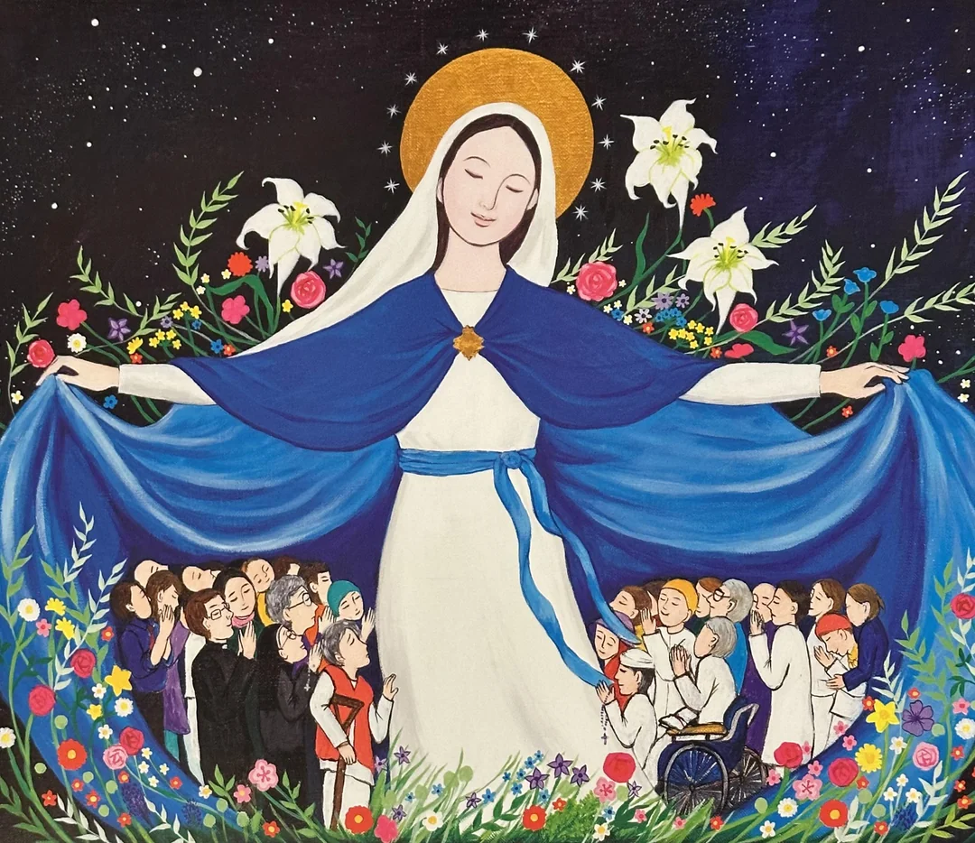
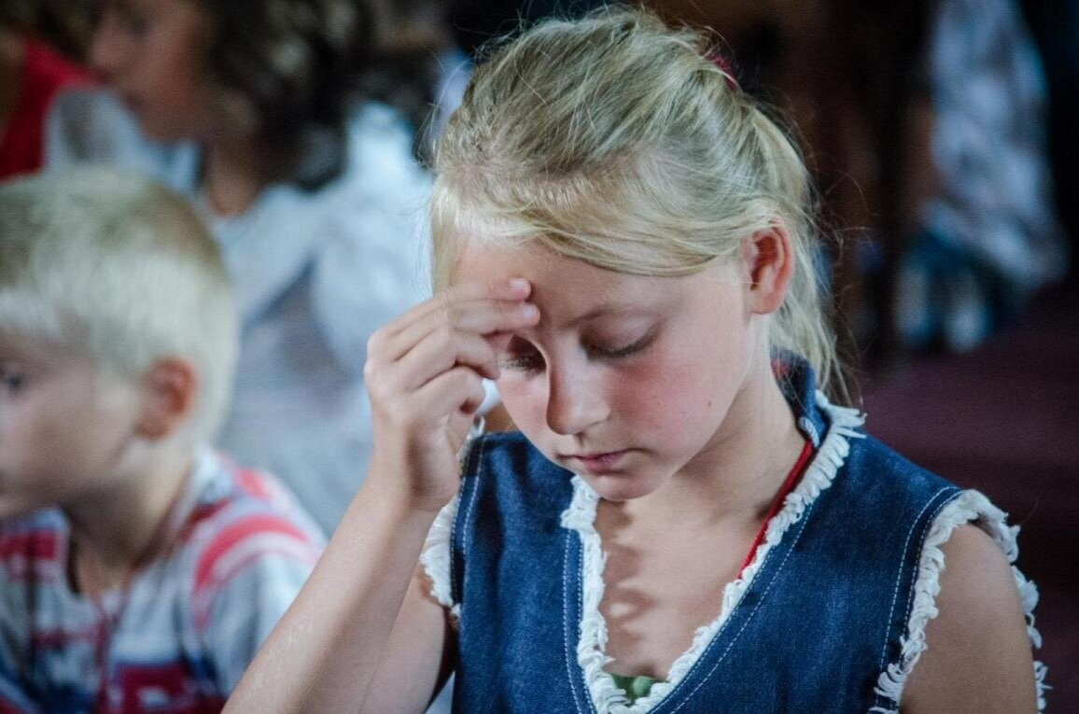
The May Procession

Slide 2
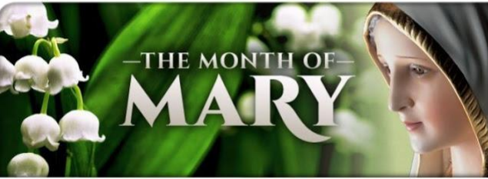
May is……

Slide 3
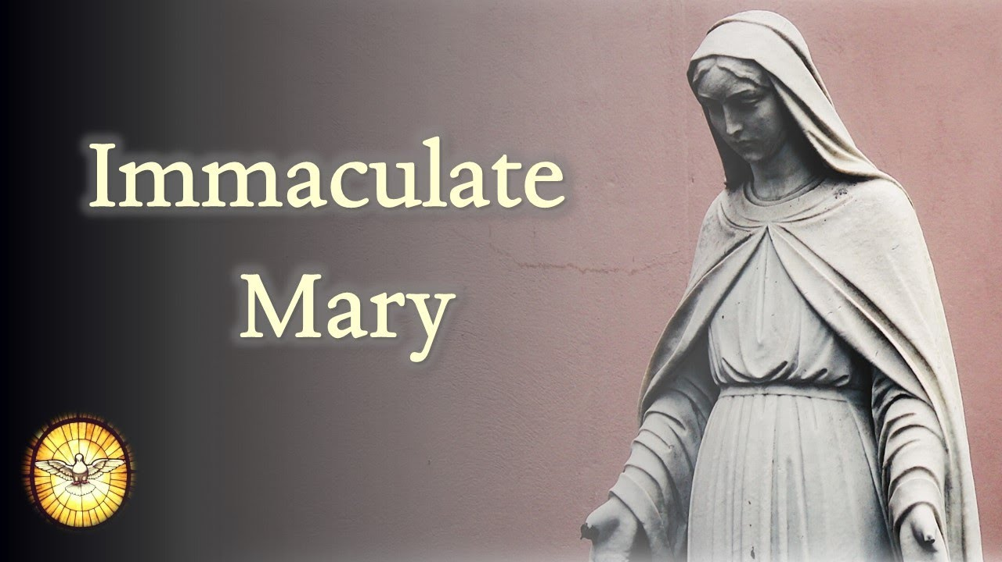
Let us sing Immaculate Mary

Slide 4
Why do we honour Mary during May?
The month of May is a special time for Catholics to honour our Blessed Mother Mary.
During this month Christians, both in church and in the privacy of the home, offer up to Mary from their hearts prayer and great respect known as veneration.
It’s the month we honour Blessed Mary as the Mother of Jesus and our Heavenly Mother. Mary is the Queen of Heaven and Mother of the church.
Mary has a unique role in salvation history as the Mother of God, conceived without Sin, who by her own free will agreed to bring the “Word made flesh", (John 1:14) our Lord and Saviour Jesus Christ into the world.

Slide 5
Crowning of Mary procession
The reason why we crown Mary is best summed up by Pope Paul VI who wrote in 1965 that May is an occasion for a “moving tribute of faith and love which Catholics in every part of the world pay to the Queen of Heaven.”
The crown symbol is attributed to Mary because she is the Mother of the Son of God, who is our Heavenly King.

Slide 6
The Annunciation Luke 1:26-38
In the sixth month the angel Gabriel was sent by God to a town in Galilee called Nazareth, to a virgin engaged to a man whose name was Joseph, of the house of David. The virgin's name was Mary. And he came to her and said, "Greetings, favoured one! The Lord is with you." But she was much perplexed by his words and pondered what sort of greeting this might be. The angel said to her, "Do not be afraid, Mary, for you have found favour with God. And now, you will conceive in your womb and bear a son, and you will name him Jesus. He will be great, and will be called the Son of the Most High, and the Lord God will give to him the throne of his ancestor David. He will reign over the house of Jacob forever, and of his kingdom there will be no end." Mary said to the angel, "How can this be, since I am a virgin?" The angel said to her, "The Holy Spirit will come upon you, and the power of the Most High will overshadow you; therefore the child to be born will be holy; he will be called Son of God. And now, your relative Elizabeth in her old age has also conceived a son; and this is the sixth month for her who was said to be barren. For nothing will be impossible with God." Then Mary said, "Here am I, the servant of the Lord; let it be with me according to your word." Then the angel departed from her.

Slide 7
The importance of the annunciation…
Is that Mary said yes to God’s plan.
Without Mary giving birth to Jesus, all the events that followed:
Jesus’ life, death, and resurrection wouldn’t have happened. So, it’s believed that May (when nature is showing signs of life) is the ideal month to honour the woman who gave life to our Saviour

Slide 8
Why is the month of May chosen?
Historians aren’t exactly sure why May was chosen to honour Mary, but many believe that May being the month when spring is in full bloom has a lot to do with it.
• May is the height of spring–gardens everywhere are alive with blooming flowers and trees are filling their branches with leaves. This new beginning and new birth in nature reminds us of the life Mary gave to Jesus.

Slide 9
How do we honour Mary in May?
Procession and Crowning of Mary with flowers
Erecting a May altar with a statue or picture of Mary as a reminder of her special month
Praying the Hail Mary ... ... We pray with her and ask her to pray for us and for God’s grace to fall on us.
• Praying the Rosary
• Praying a Novena
• Reciting the Litany of the Blessed Virgin Mary

Slide 10
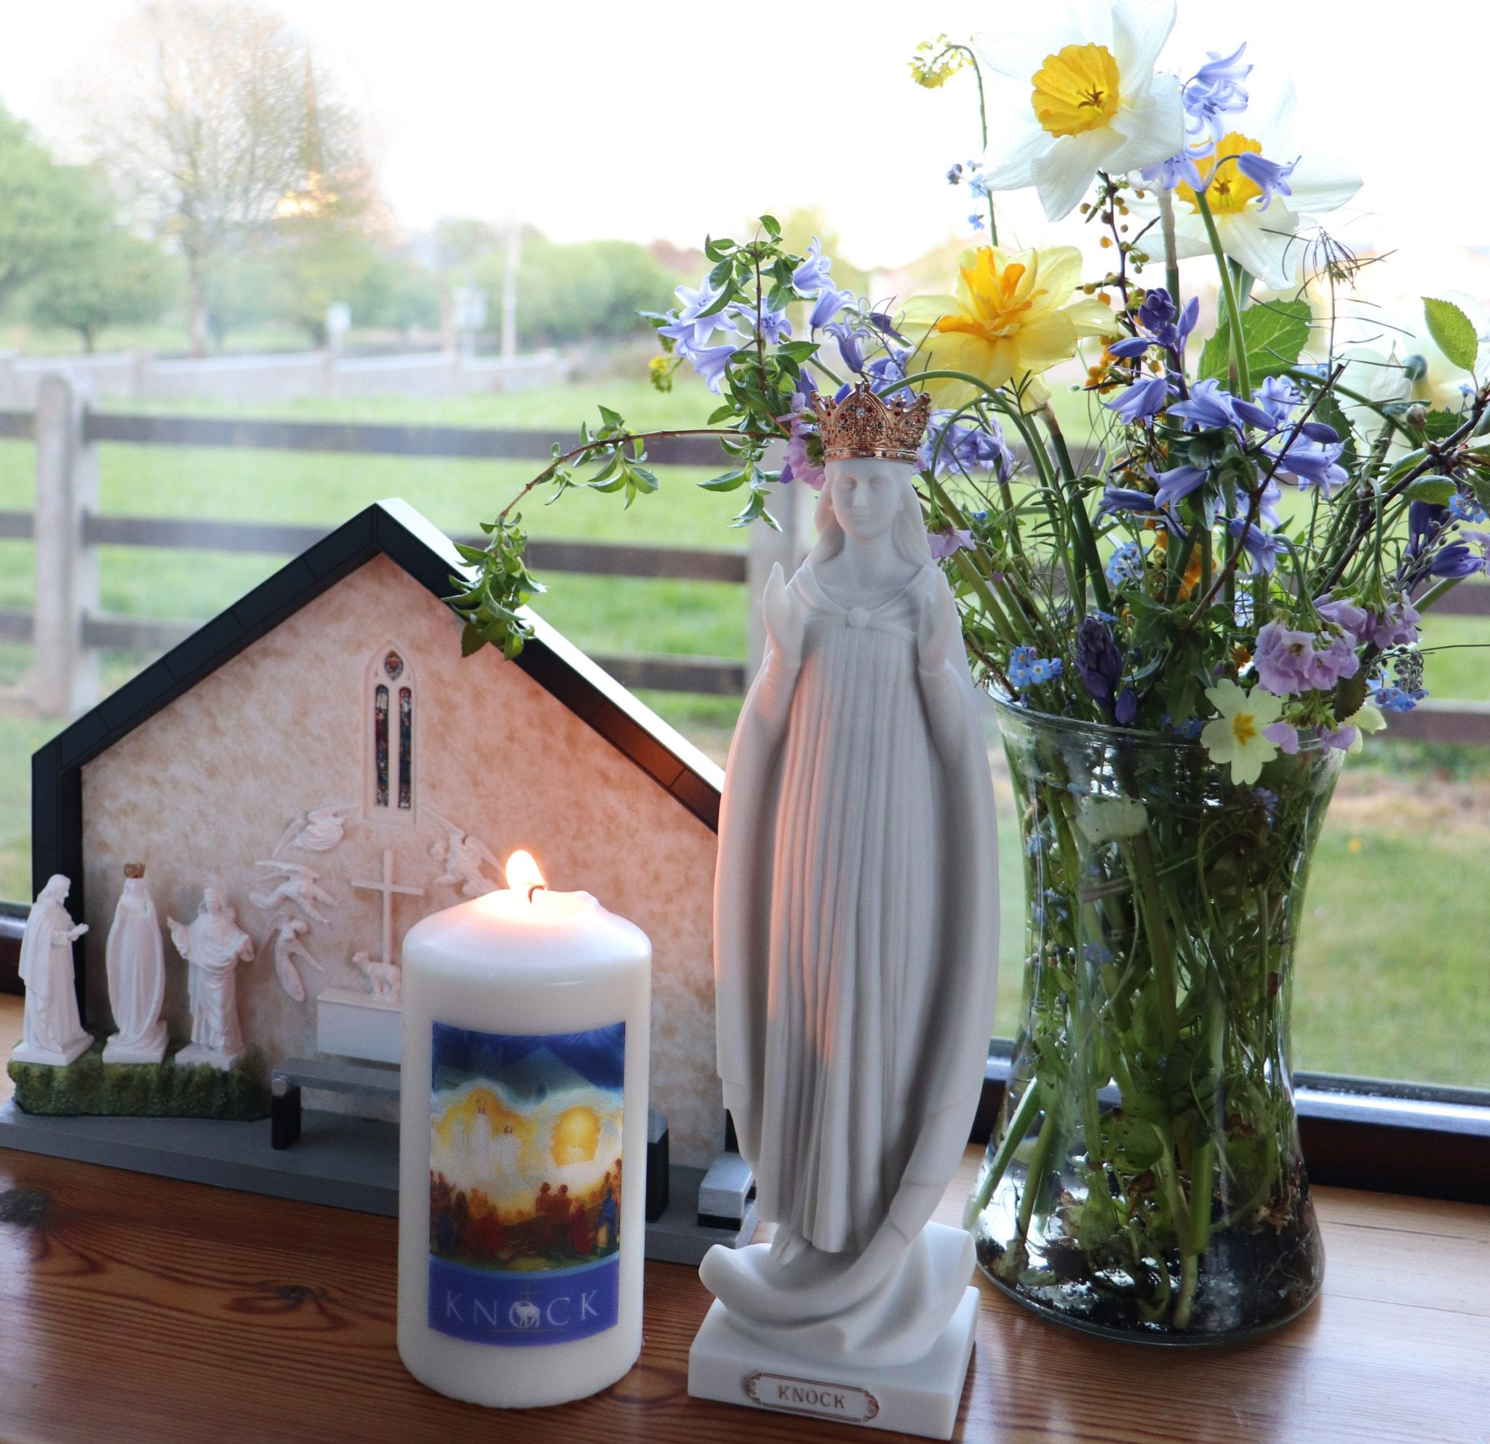
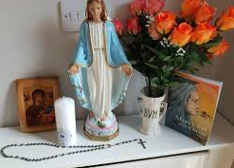
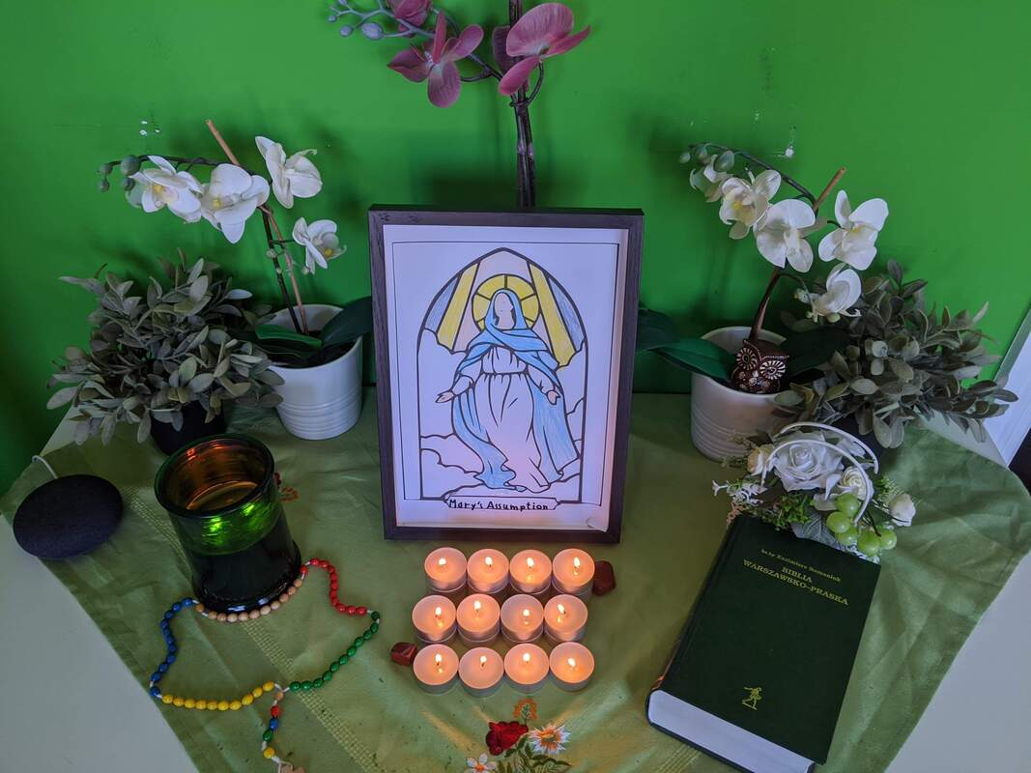
Making a May Altar
  Try this at home. Use rosary beads, a picture or statue of Mary, some candles and flowers.

Slide 11
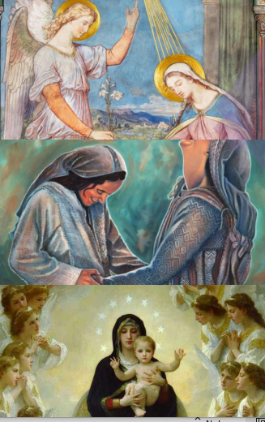
Praying the Hail Mary
The Hail Mary is probably the most
popular prayer to Mary and has its basis
in Sacred Scripture. The opening of the prayer begins with ..
When the Angel Gabriel was sent to Mary by the Father, he greeted her. “Hail, full of
grace, the Lord is with you!” ( Luke 1:28)
Then the next part is When Mary visited Elizabeth, Elizabeth
exclaimed, “ Blessed are you among
women, and blessed is the fruit of your
womb!” (Luke 1:41 – 42)
The second part of the prayer is in
response to the first, asking Mary to pray
for us and addressing her as the Mother
of God.

Slide 12
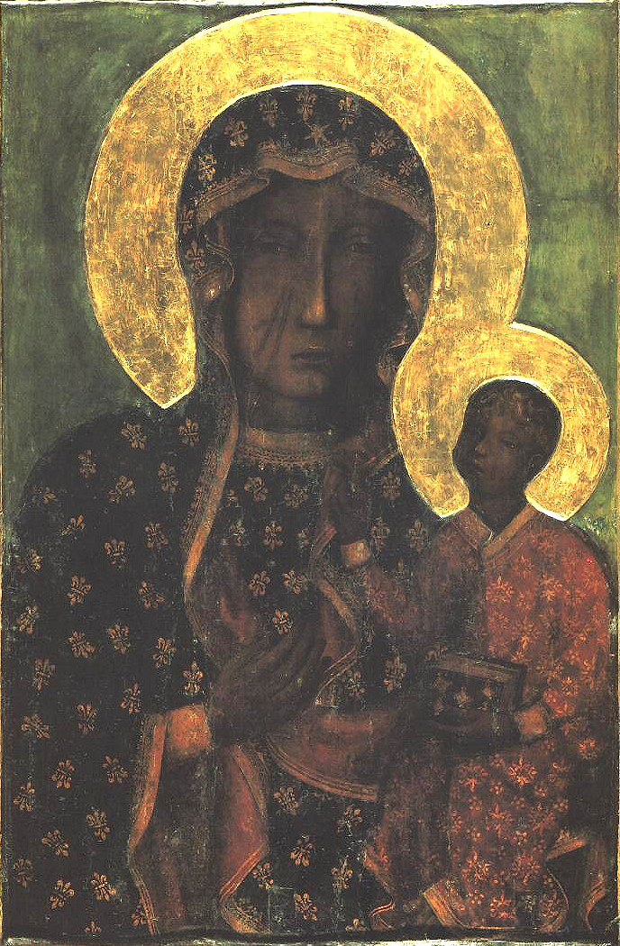
The procession and crowning
We will now process to the statue of Mary in the prayer garden. As we do we will sing the Hail Mary.
https://www.youtube.com/watch?v=PglEF7mTf2E

Slide 13
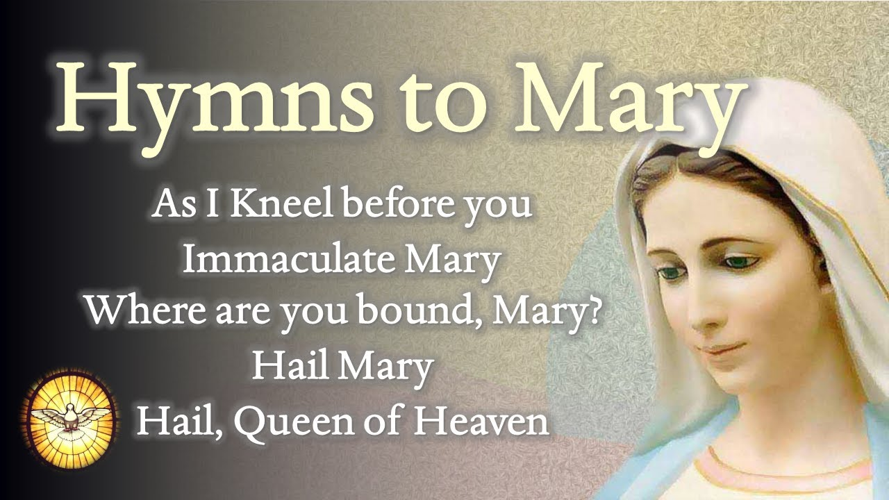
Songs for the procession

Slide 14
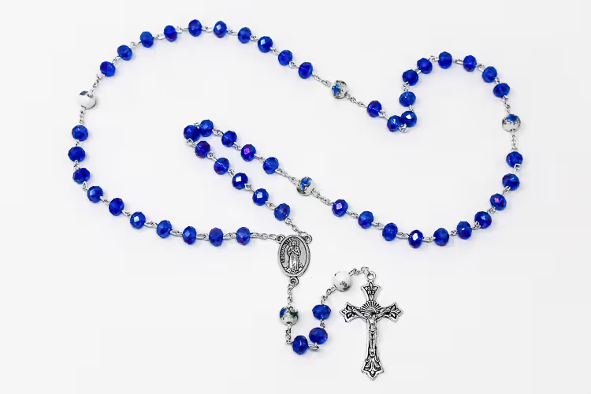
Let us say a decade of the rosary
“The Fifth Glorious Mystery – The Coronation of Mary as Queen of Heaven and Earth”
Our Father.
Followed by
10 Hail Mary’s

Slide 15
Going forth
Think how YOU can be more like Mary
Let us finish with a final prayer:
We ask Mary to watch over us and guide us closer to Jesus. May her example inspire us to love God and serve others.
Amen

Slide 16
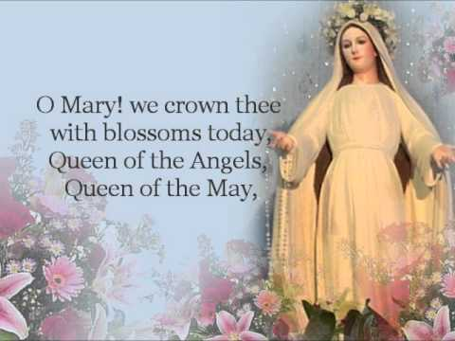
Final hymn

Slide 17
To think about…
Mini Vinnies to lead procession service
Where to start/end Hall or church
Direction of procession and order of year groups MiniVinnies to lead each group
Caitlin & Finn to do crowning Finn hold the cushion with the crown and Caitlin to do crowning are they at the end or start of the procession -do they say anything
Say the rosary during procession? Sing hymns-which?
Y4 with prayer buddies in reception
Pupils to bring in flowers from home?
Go forth-Be like Mary

