Slide 1
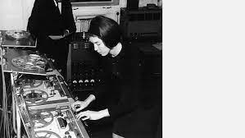
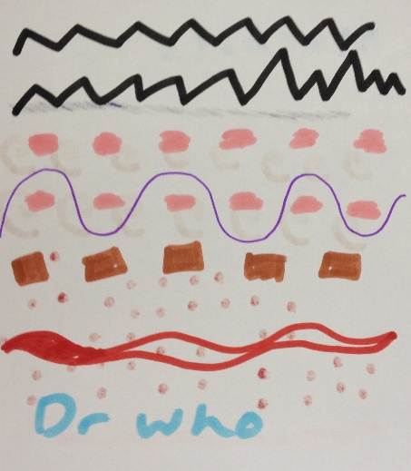
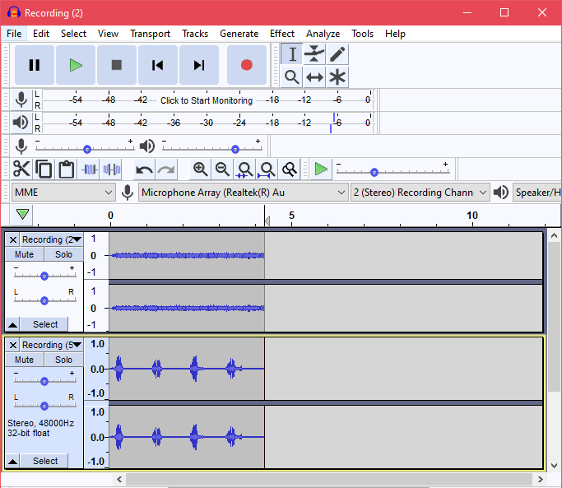
Year 6: Spring 1 – Doctor Who
Key Vocabulary
Found sound | Sounds found in the ‘natural’ world or made from non-musical objects to make music
Graphic score | A visual representation of music
Melody | Another word for ‘tune’. A musical sentence
Orchestrate | Choose which instruments perform which parts of the music
Ostinato | A repeating (Often rhythmic) pattern
Loop | A sound that is played continuously
Delia Derbyshire
Composer of electronic music. Her most famous composition is the Doctor Who theme tune.
Graphic Score Example
Audacity
Add audio and save work
Manipulate sounds
Cut out unwanted audio
Listen to one sound at a time

