Slide 1
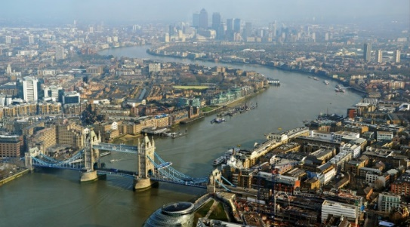
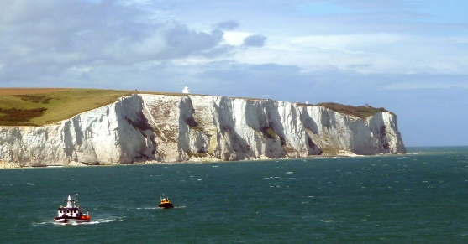
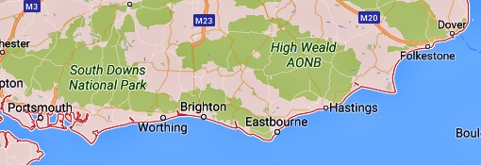
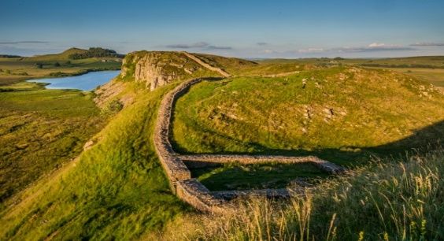
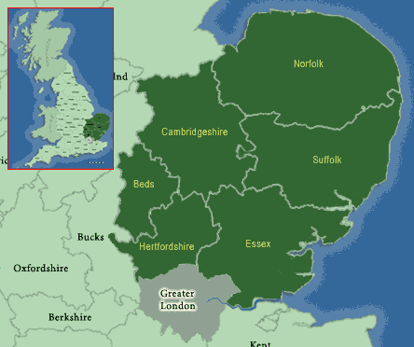
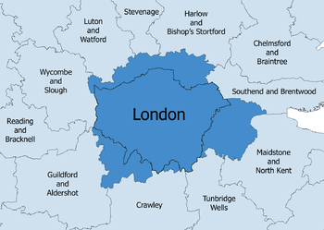
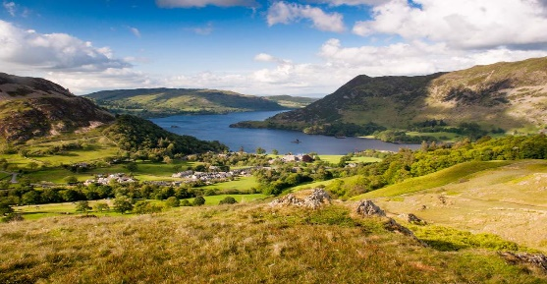
Knowledge Organiser – Geography – Year 4)
Landmark | Image
London River Thames and Tower Bridge
South Coast White cliffs of Dover
North England Hadrian’s Wall
Nation Parks The Lake District
Key Vocabulary | Definition
Conurbation | An area grown so large it includes surrounding urban areas.
Population | The amount of people that live in a particular geographical area.
Port | A town or city with a harbour or access to water where ships load or unload.
Relief | The difference between the highest and lowest elevations in an area.
National Park | Protected areas because of their beautiful countryside, wildlife and cultural heritage.
World Heritage Site | A landmark or area which is selected as having cultural, historical, scientific or other form of significance, and is legally protected by international treaties.
England’s South Coast
East Anglia
London
Conurbation

