Slide 1
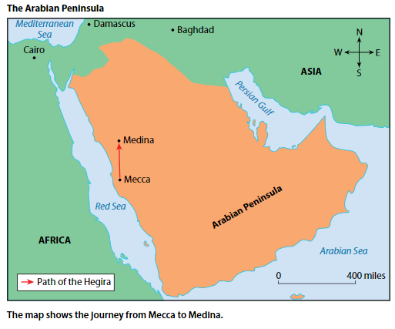
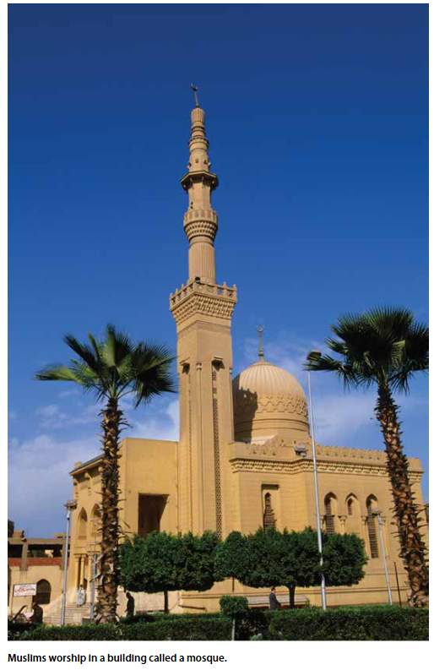
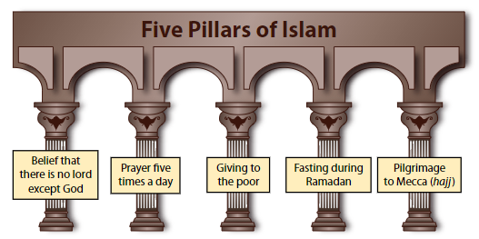
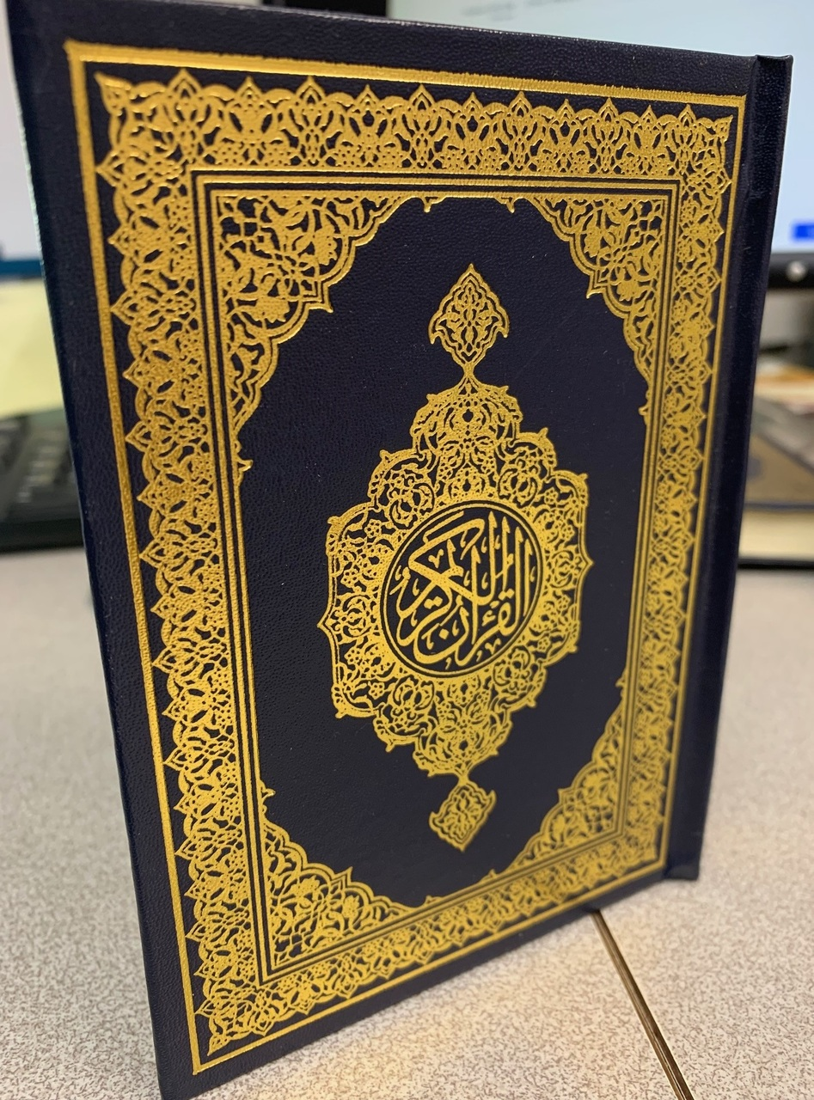
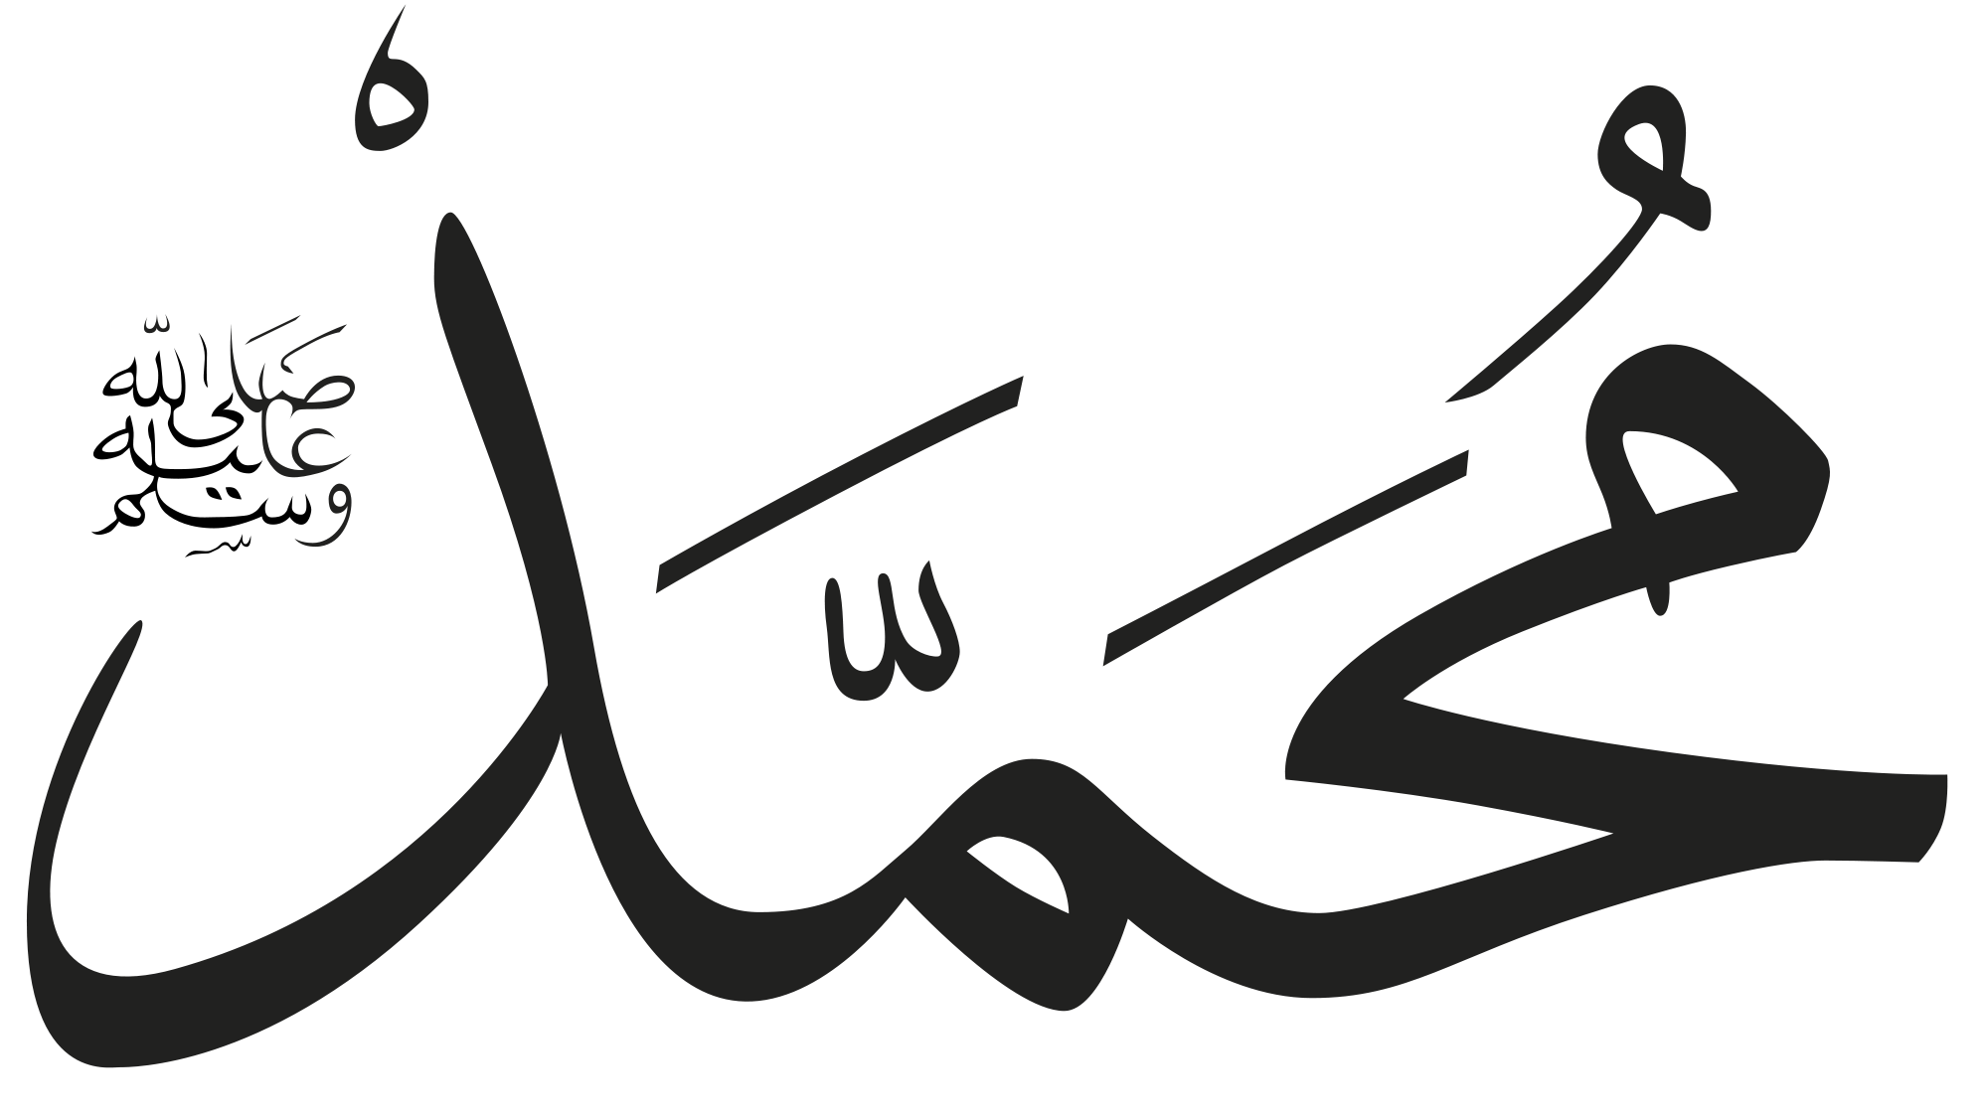
Our Knowledge Organiser
Early Islamic Civilisation
Key Vocabulary | Definition
Five Pillars of Islam | The five obligations that every Muslim must satisfy to live a good and responsible life according to Islam.
Muhammad | The founder of Islam and the proclaimer of the Qurʾān
Caliph | A successor of Muhammad; the leader of Islam
Qur’an | The central religious text of Islam, believed by Muslims to be a revelation from God
Allah | The name of God for Muslims
Mecca | A city in Saudi Arabia, which is the holiest city in Islam because the Prophet Mohammed was born there. All Muslims face towards Mecca when they pray.
Mosque | A place of worship for Muslims
Pilgrimage (hajj in Arabic) | A journey undertaken for a religious purpose
Ramadan, n. | A holy month in the Islamic calendar when Muslims fast from sunrise to sunset
Muhammad in Arabic
Qur’an

