Slide 1
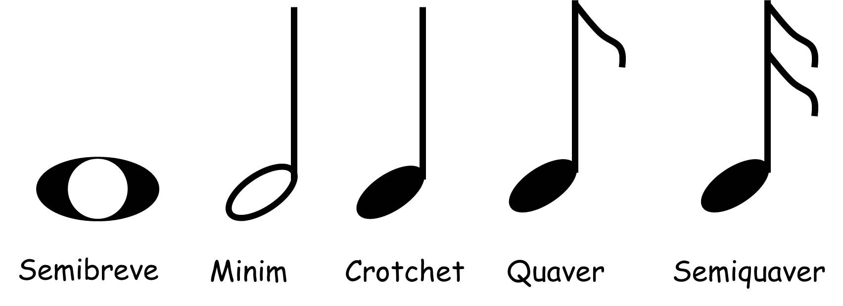
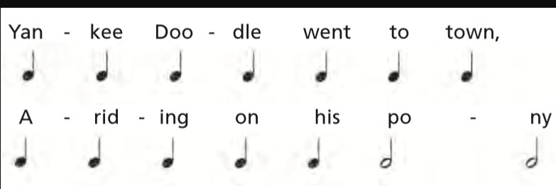
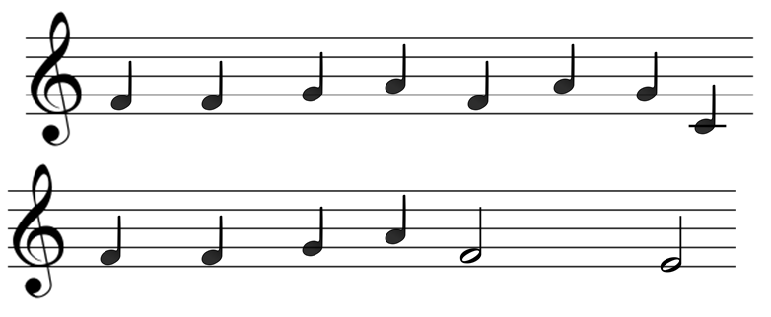
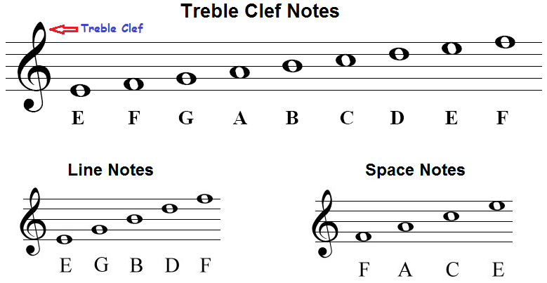
Year 4: Spring 2 – Elements of Music
Key Vocabulary
Treble Clef | A symbol used in musical notation that assigns notes to lines and spaces on the musical staff.
Stave | The name given to the five horizontal lines on which we can write music.
Crotchet | 1 beat
Minim | 2 beats
Semibreve | 4 beats
Quaver | ½ beat
Yankee Doodle
Semibreve
4 beats
Minim
2 beats
Crotchet
1 beat
Quaver
½ beat

