Slide 1
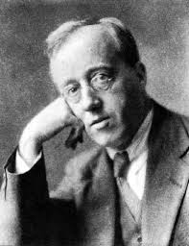

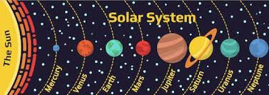
Year 4: Spring 1 – Gustav Holst
Key Vocabulary
Composer | Someone who writes music.
Inspiration | Something that stimulates you to feel or do something.
Solar System | The bound system of the sun and the objects that orbit around it.
Suite | A collection of short musical pieces which can be played one after another.
Eerie | A word that means strange, mysterious and sometimes frightening.
Mars Angry and ominous. Drum beat with a military feel.
Venus Slow and beautifully eerie. Relaxing harps, flute and solo violin.
Mercury Quick and powerful. High-pitched harp, flute and glockenspiel.
Jupiter Impressive and majestic. Brass and slow waltzing strings.
Uranus Heavy timpani bowls to a boisterous gallop. Full orchestra.
Neptune Beautiful harp and string melodies with a mystical choir.
Gustav Holst
1874 - 1934
British Composer
The Royal College of Music
London

