Slide 1
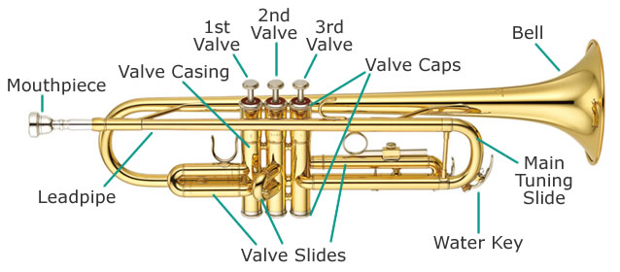
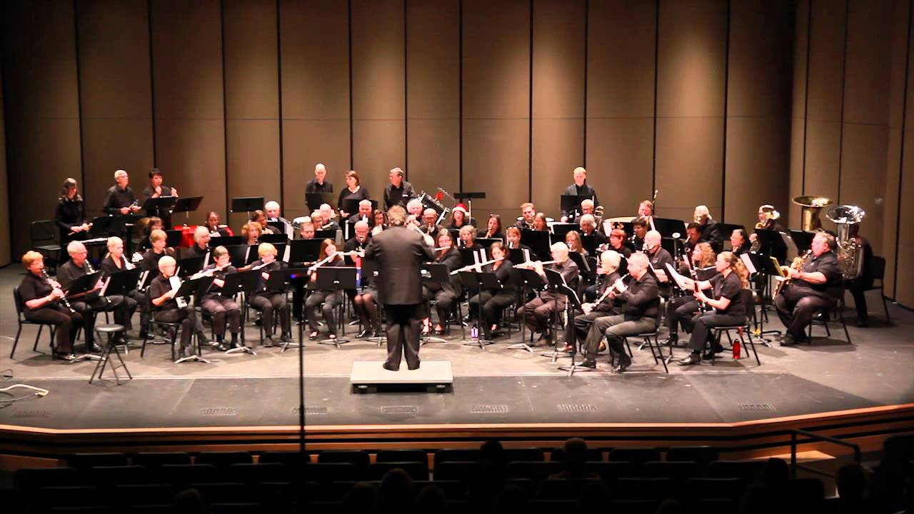
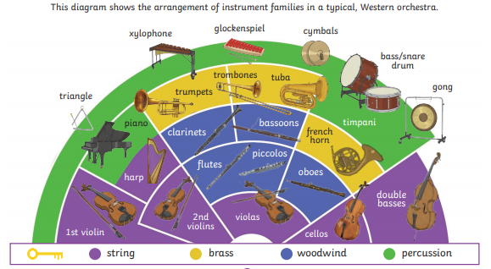
Year 4: Autumn 1 – Let’s Join the Orchestra
Key Vocabulary
Percussion | Instruments played by striking with the hand, stick, beater or shaking.
Brass | Brass wind instruments include trumpet, horn and trombone.
Woodwind | Forming a section of an orchestra, including flutes, oboes, clarinets and bassoons.
String | Forms a section of the orchestra that includes the harp, violin, viola, double bass and cello.
National Anthem | A song officially adopted by a country as an expression of national identity
Orchestra
Trumpet

