Slide 1
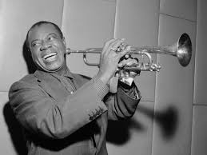
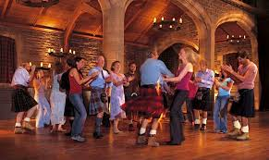
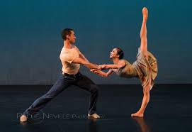
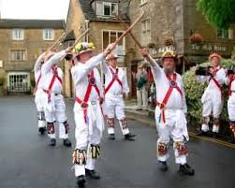
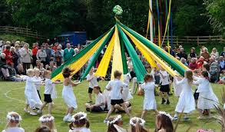
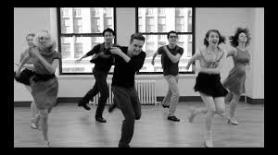
Year 2: Spring 2 – Music Makes You Move
Key Vocabulary
Jazz | A music genre that originated in New Orleans, USA
Gospel Music | A music genre of Christian music
Improvisation | Changing the tune and the lyrics of a song
Pitch | How high or low a note is
Dynamics | Describes the volume of a sound or note
Louis Armstrong
1901 – 1971
Famous Jazz player
Ceilidh Dancing – pronounced KAY- lee. People dance in groups with a partner.
Ballet is a French word which comes from Latin ballo, ballare, meaning "to dance“.
Morris dancing
This is a form of English folk dance usually accompanied by music. Dancers may hold sticks, swords and handkerchiefs.
Maypole dancing
Dancing around a maypole involves a group of people taking a coloured ribbon attached to it and weaving around each other, often to music.
Tap dancing is a kind of dance featuring loud tapping sounds from shoes with metal plates on the heels and toes.

