Slide 1
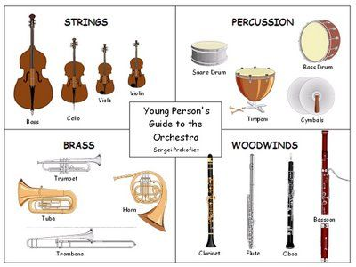
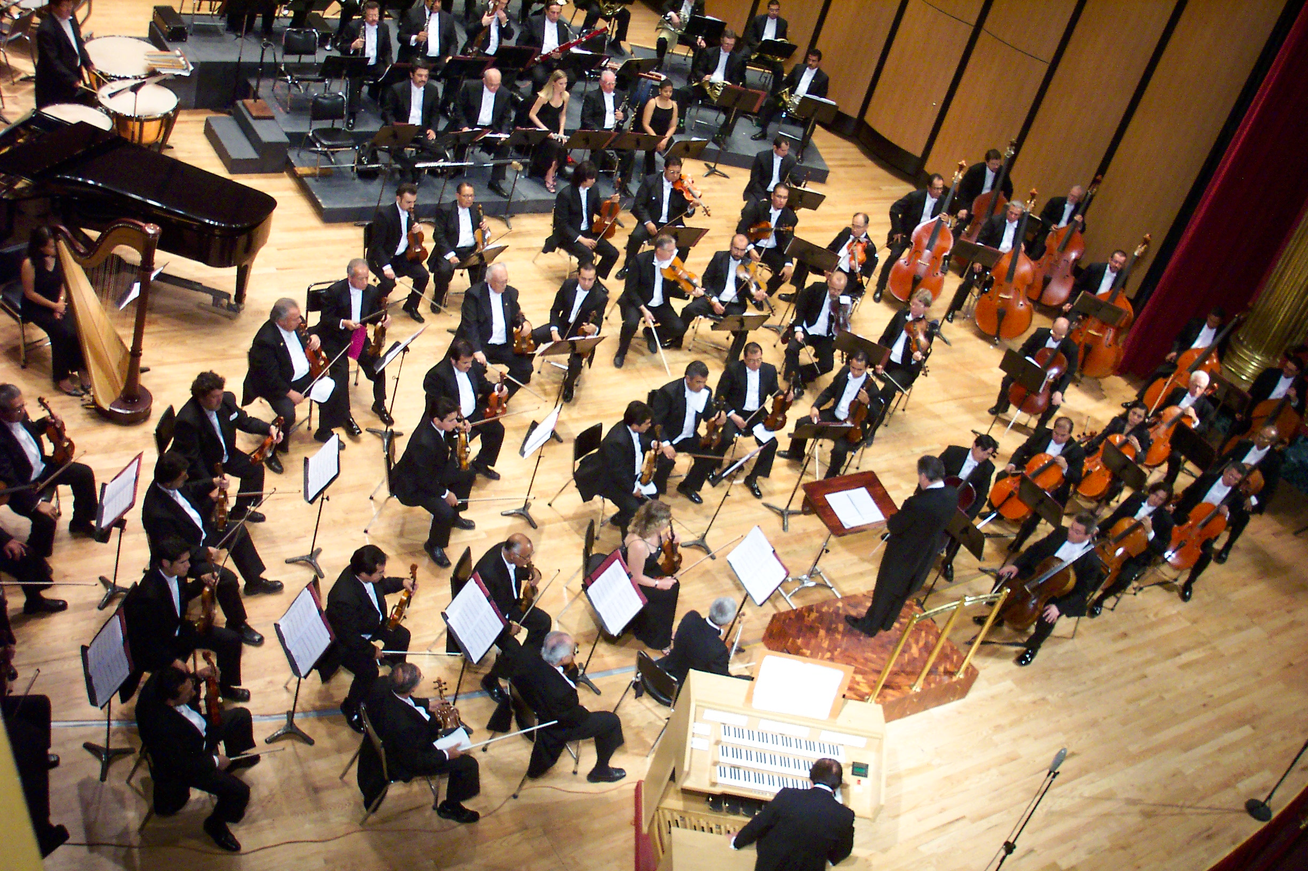
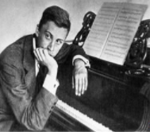
Year 2: Autumn 1 – Instruments and their families
Key Vocabulary
Orchestra | A group of musicians who play lots of instruments together
Conductor | Leads and orchestra something with a baton
Motif | A short musical idea
Peter and the Wolf | A musical story composed by Sergei Prokofiev
Musical family | Groups instruments into different categories
Orchestra
Sergie Prokofiev
1891-1953

