Slide 1
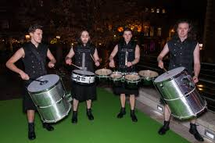
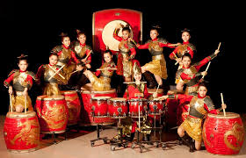
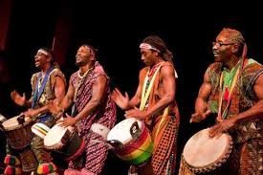
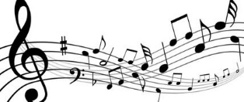
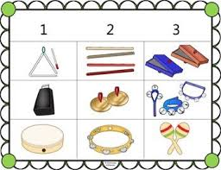
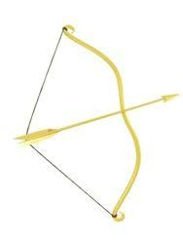
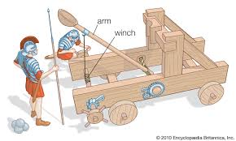
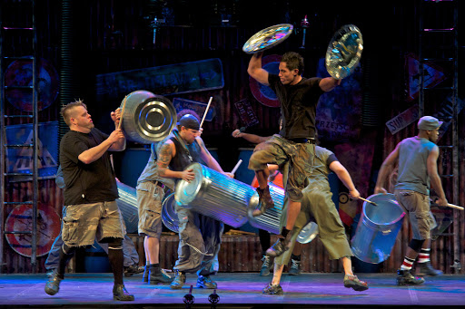
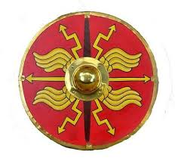
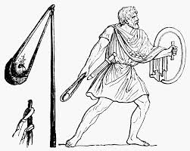
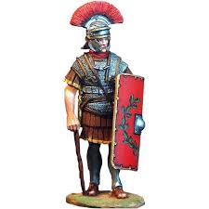
‘I’ve got rhythm’
Y2 Summer 2
Irish Drummers
African Drummers
Chinese drummers
Vocabulary
1. Rhythm -is what makes music move and a big part of rhythm is called the beat'
2. Non- pitched percussion -
is anything that you strike, shake, or scrape. Examples of these are cymbals, tambourine, triangle
3. Pitch – describes how low or high a note sounds
4. Steady beat - steady, repetitive pulse that occurs in songs
5. Call and response –someone claps a rhythm, then other people will repeat it back as an echo.
Non pitched percussion instruments
Roman catapult
Roman bow and arrow
Roman shield
STOMP is a percussion group that uses the body and ordinary objects to create amazing rhythms and acrobatic
Roman slingshot
Roman centurion

