Slide 1
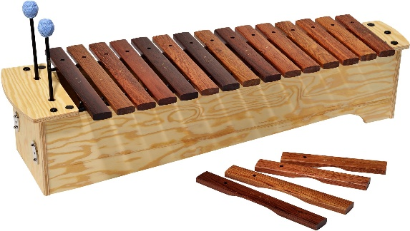
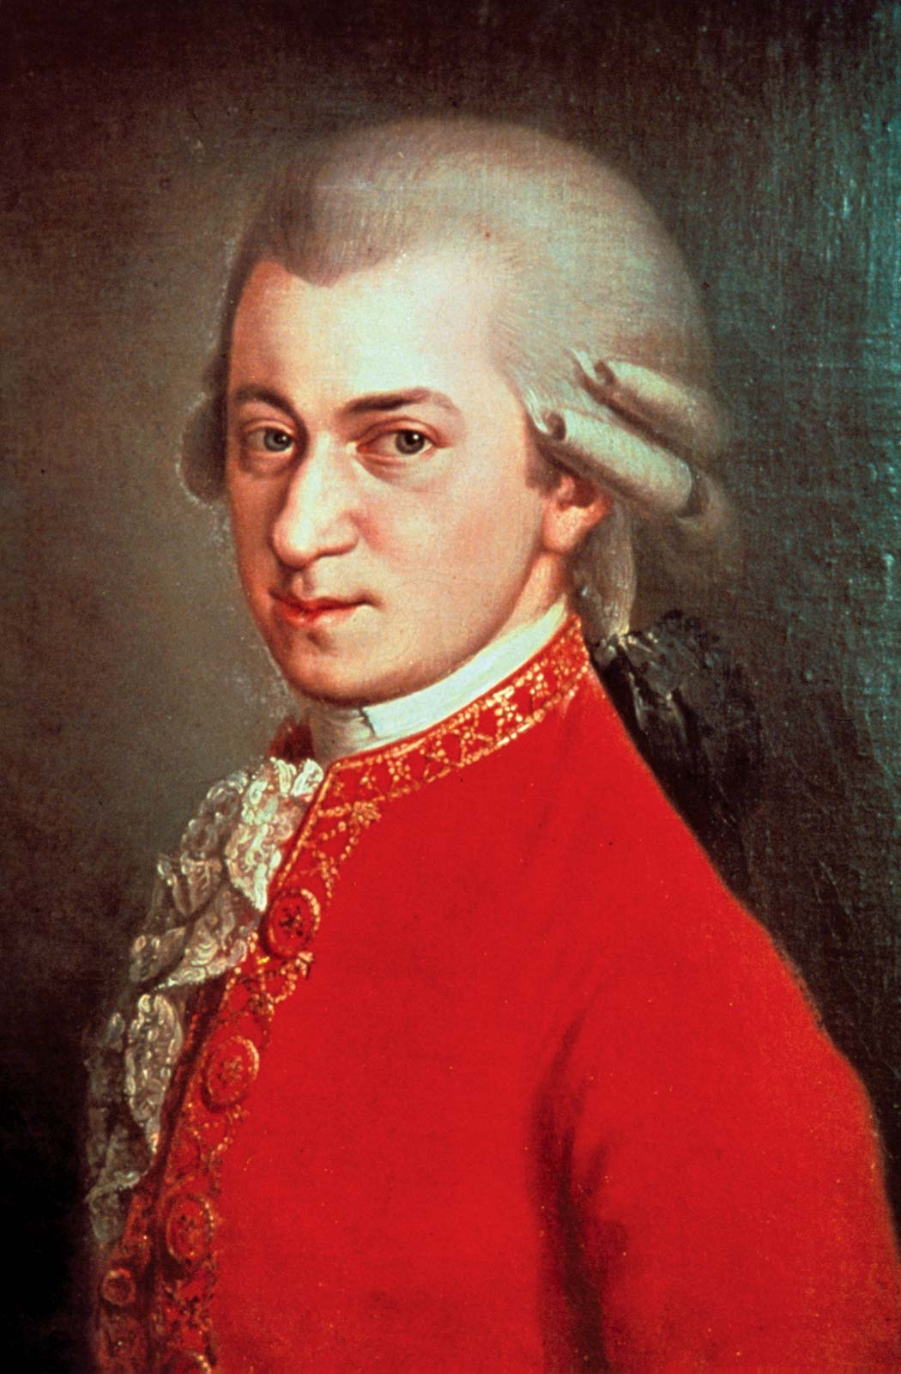
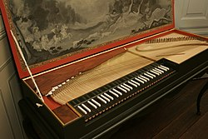
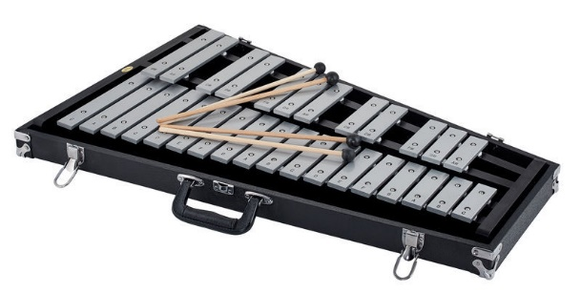
Year 2: Autumn 2 - Mozart
Key Vocabulary
Composer | A person who writes music
Classical music | music
Opera | A form of theatre in which music has a leading role.
Tempo | Fast or slow
Allegro | Means lively and fast
Xylophone
Clavier
Wolfgang Mozart
1756-1791
Glockenspiel

