Slide 1
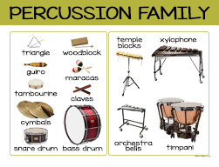
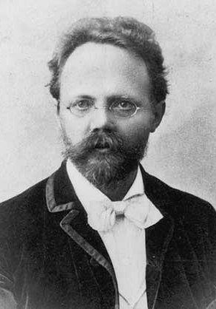
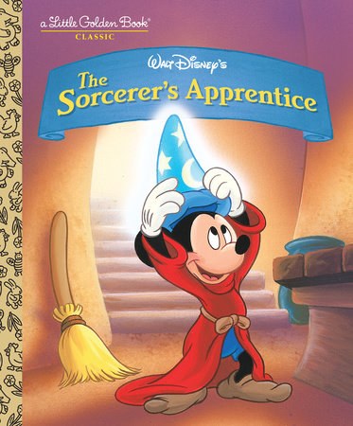
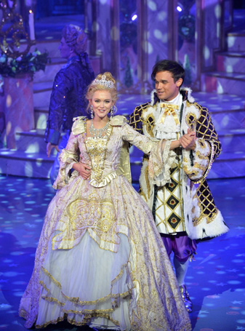
Year 2: Spring 1 – Music Can Tell A Story
Key Vocabulary
Percussion instrument | Make a sound when they are struck, shaken, scraped, plucked or rubbed.
Opera singers | Act out a story on stage through singing.
Opera | A form of theatre in which music has a leading role.
Tempo | Fast or slow
Allegro | Means lively and fast
Engelbert Humperdink
1854 – 1921
A German composer.
Written by Johanne Wolfgang Von Goethe, a German writer. Paul Dukas , a French Composer, wrote the music for The Sorcerer’s Apprentice
Gloachino Antonio Rossini, an Italian composer, made Cinderella into an opera in 1817.

