Slide 1
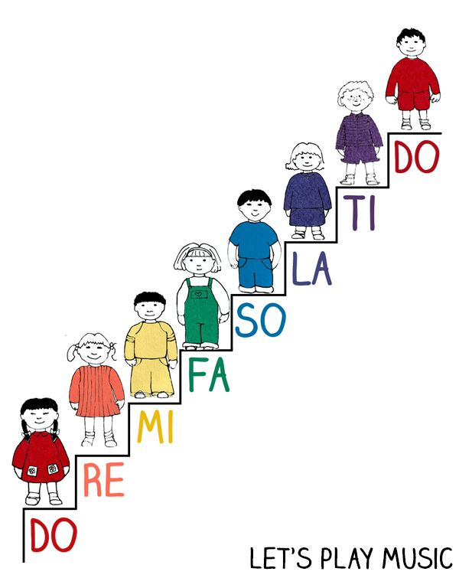
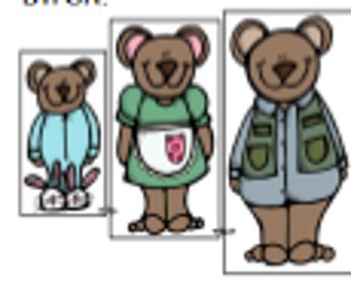
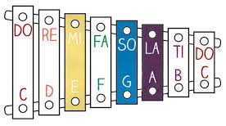
Year 1: Summer 1 - Pitch
Key Vocabulary
Steady beat | Sound you hear over and over again
Tempo | Fast or slow
Dynamics | Loud or quiet
Pitch | High or low soudns
Repetitive | Copying notes or rhythm in a piece of music
High Pitch
Low Pitch
High Pitch
Middle Pitch
Low Pitch

